Slide 1


Immunohistochemical Image Generation using Deep Learning
by Philipp Rosin

Slide 2
Table of Contents
Introduction
Task Description
Medical Background
Data Set
Methodology
Experiments
Evaluation
Results
Conclusion & Outlook

Slide 3
Task Description
Breast Cancer Immunohistochemical Image Generation Challenge (published on grand-challenge.org)
paired image translation between two histochemical stainings

Slide 4
Histological Staining
Histological stains are applied to highlight specific features and structural elements of the tissue by their color and/or staining intensity.

Slide 5
Histological Staining
H&E staining:
H&E staining is the gold standard in Histopathology it provides information about cellular structure and morphology
Hematoxylin stains cellular nuclei and other basophilic structures blue-purple
Eosin stains cytoplasm, extracellular matrix, and other acidophilic structures pink or red.

Slide 6
Histological Staining
H&E staining:
H&E staining is the gold standard in Histopathology it provides information about cellular structure and morphology
Hematoxylin stains cellular nuclei and other basophilic structures blue-purple
Eosin stains cytoplasm, extracellular matrix, and other acidophilic structures pink or red.
IHC staining:
is used to localise specific proteins and biomarkers
the primary antibody binds to a specific antigen
the secondary antibody binds to the primary one to visually stain the tissue
samples can have 4 IHC scores (0, 1+, 2+ ,3+)

Slide 7
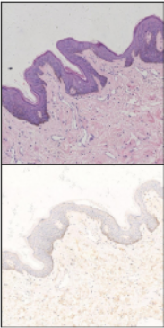
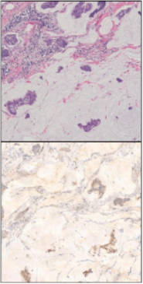
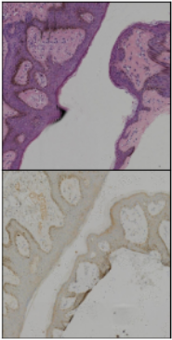
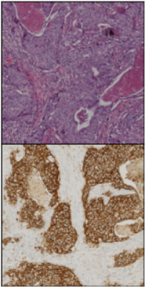
IHC Scoring
H&E img
IHC img
score 0: No staining or minimal staining negative medical result
score 1+:Weak or faint staining is observed considered often as negative result
score 2+:moderate staining intensity considered as positive result
score 3+:intense staining is observed considered as positive result

Slide 8
Data Set
BCI challenge train set was used for training
BCI challenge validation set was used for testing
all [1024 x 1024] images were cut into 16 individual [256 x 256] patches
set | all scores | 0 (negative) | 1+ (weak) | 2+ (moderate) | 3+ (strong)
train | 54336 [3396] | 2752 [172] | 12864 [804] | 23616 [1476] | 15104 [944]
test | 8000 [500] | 480 [30] | 1840 [115] | 3536 [221] | 2144 [134]

Slide 9
Architectures
U-Net S | 3 steps 16 hidden features
U-Net M | 4 steps 32 hidden features
U-Net L | 5 steps 64 hidden features
ViT S | 1 block 2 heads
ViT M | 2 blocks 4 heads
Swin T | 2 stages and 22 hidden features
Pix2Pix U-Net L | 5 steps 64 hidden features
Pix2Pix ViT S | 1 block 2 heads
Pix2Pix Swin | 2 stages and 22 hidden features
Diffusion Model | t = 1000 denoising steps

Slide 10
Evaluation
Quantitative evaluation
quantify the performance of the networks on the train and test set based on three metrics:
1) MSE
2) SSIM
3) PSNR

Slide 11
Evaluation
Quantitative evaluation
quantify the performance of the networks on the train and test set based on three metrics:
1) MSE
2) SSIM
3) PSNR
Qualitative evaluation
visual inspection of the generated images
using a pretrained classifier to predict the IHC score on the generated images

Slide 12
MSE Results
Network | all scores | 0 (negative) | 1+ (weak) | 2+ (moderate) | 3+ (strong)
U-Net L | 0.0153 | 0.0154 | 0.0097 | 0.013 | 0.0237
Pix2Pix U-Net | 0.0163 | 0.0138 | 0.0098 | 0.0126 | 0.0286
Swin T | 0.0211 | 0.0184 | 0.0253 | 0.0175 | 0.0238
U-Net M | 0.0216 | 0.0272 | 0.0178 | 0.0211 | 0.0244
Pix2Pix Swin T | 0.0225 | 0.0194 | 0.0285 | 0.0191 | 0.0236
ViT M | 0.0238 | 0.0227 | 0.0252 | 0.0211 | 0.0271
Pix2Pix ViT | 0.0238 | 0.0218 | 0.0273 | 0.0206 | 0.0265
ViT S | 0.024 | 0.0237 | 0.0246 | 0.0214 | 0.0279
U-Net S | 0.0247 | 0.0186 | 0.0184 | 0.0208 | 0.038
(Diffusion Model) | 0.1982 | 0.2523 | 0.2294 | 0.2023 | 0.1526

Slide 13
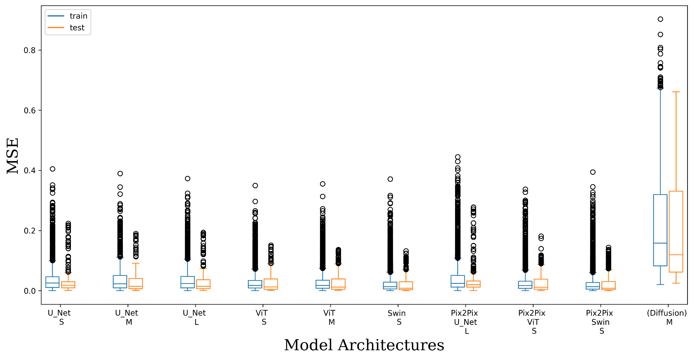
MSE Results

Slide 14
SSIM Results
Network | all scores | 0 (negative) | 1+ (weak) | 2+ (moderate) | 3+ (strong)
U-Net S | 0.6588 | 0.6865 | 0.6796 | 0.6812 | 0.5979
U-Net L | 0.6578 | 0.6887 | 0.6797 | 0.681 | 0.5938
U-Net M | 0.6537 | 0.6769 | 0.6744 | 0.6758 | 0.5942
Pix2Pix U-Net | 0.6487 | 0.6794 | 0.669 | 0.6719 | 0.586
Pix2Pix Swin T | 0.6415 | 0.6701 | 0.6532 | 0.6632 | 0.5893
Swin T | 0.6387 | 0.6683 | 0.6497 | 0.6599 | 0.5875
ViT S | 0.5343 | 0.5772 | 0.5434 | 0.549 | 0.4925
ViT M | 0.5216 | 0.5713 | 0.5285 | 0.5347 | 0.483
Pix2Pix ViT | 0.4575 | 0.52 | 0.4613 | 0.4687 | 0.4218
(Diffusion Model) | 0.0515 | 0.1208 | 0.0496 | 0.0511 | 0.0383

Slide 15
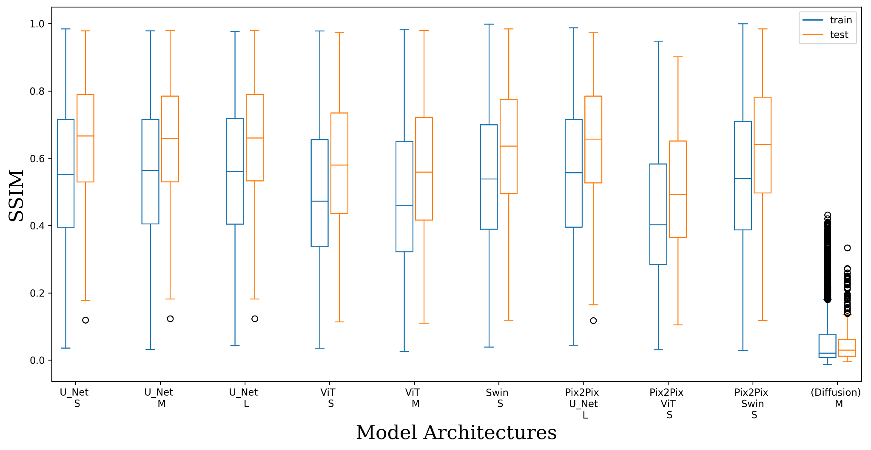
SSIM Results

Slide 16
PSNR Results
Network | all scores | 0 (negative) | 1+ (weak) | 2+ (moderate) | 3+ (strong)
U-Net L | 19.9473 | 20.2252 | 21.7585 | 20.0396 | 18.1784
Pix2Pix U-Net | 19.7441 | 20.3757 | 21.2865 | 20.1491 | 17.611
Swin T | 19.3705 | 18.5268 | 19.9536 | 19.5208 | 18.8111
Pix2Pix Swin T | 19.1378 | 19.4654 | 19.176 | 19.2316 | 18.8772
Pix2Pix ViT | 18.0566 | 18.2222 | 18.5888 | 17.987 | 17.6775
U-Net M | 18.363 | 17.2796 | 19.586 | 18.3018 | 17.6568
ViT M | 17.7402 | 18.0351 | 18.3125 | 17.6378 | 17.352
ViT S | 17.5417 | 17.8484 | 18.0871 | 17.4724 | 17.1194
U-Net S | 16.6213 | 18.9985 | 17.4398 | 16.5461 | 15.5106
(Diffusion Model) | 9.3013 | 7.947 | 8.3225 | 8.6548 | 11.5108

Slide 17
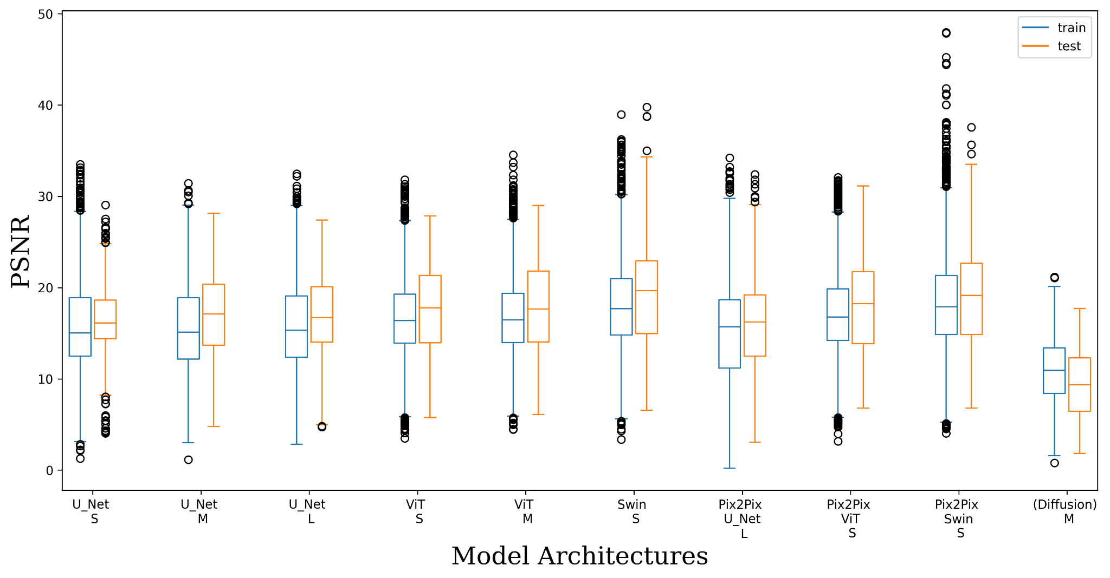
PSNR Results

Slide 18
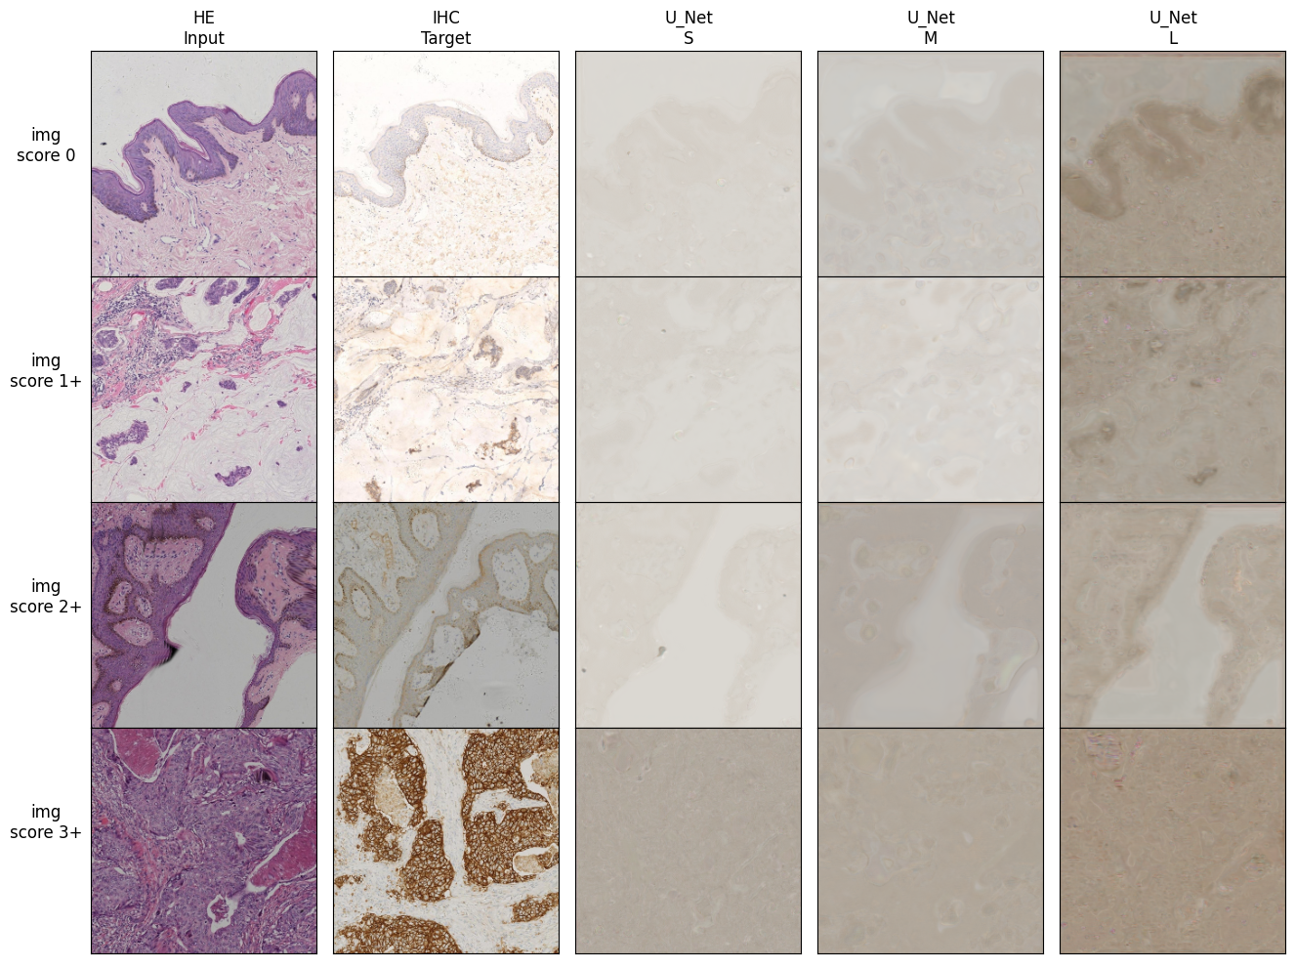
Qualitative Results U-Net

Slide 19
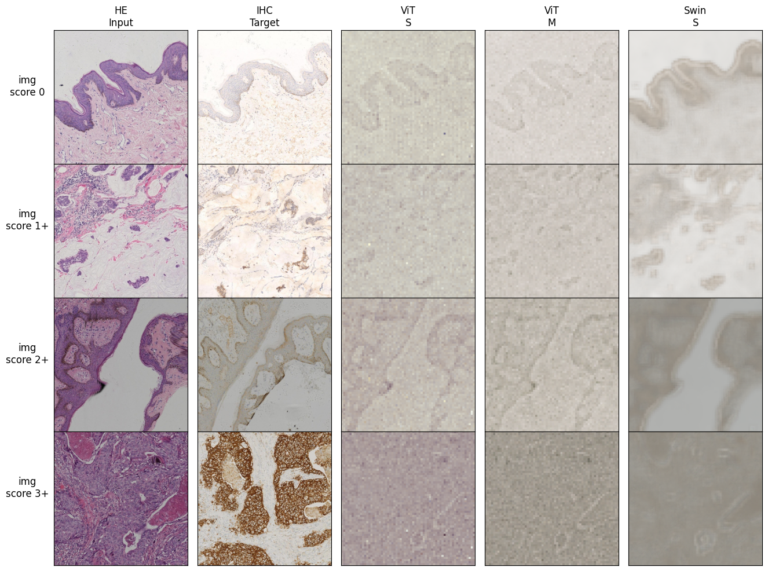
Qualitative Results ViT

Slide 20
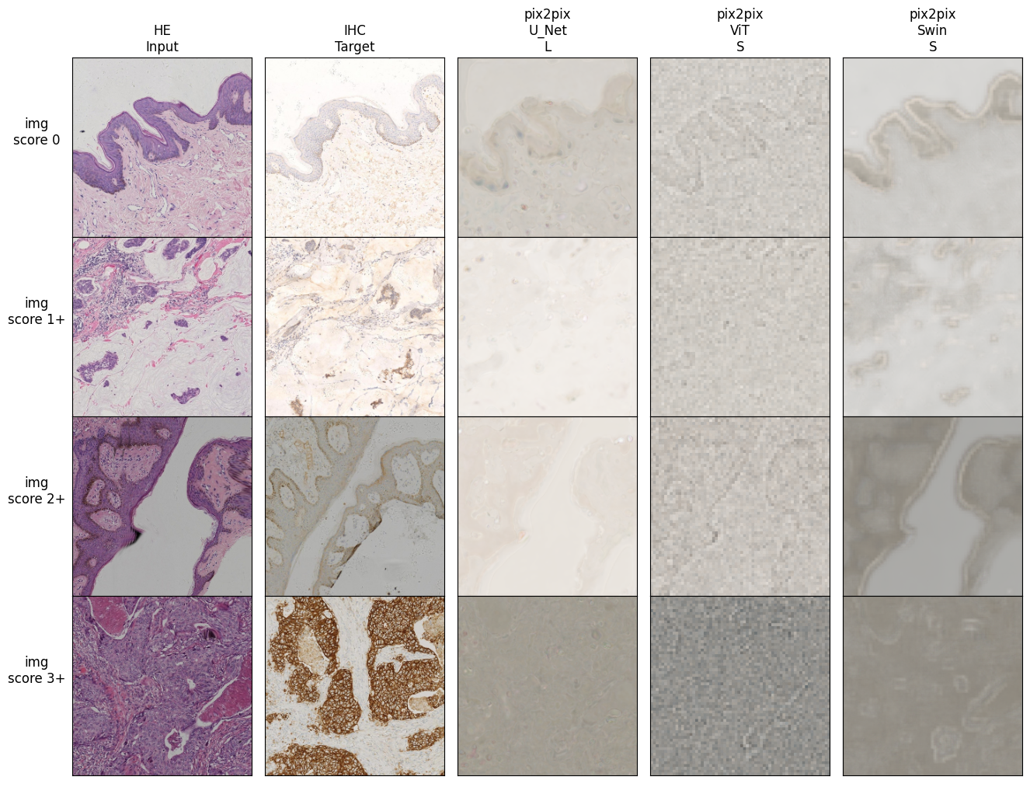
Qualitative Results Pix2Pix framework

Slide 21
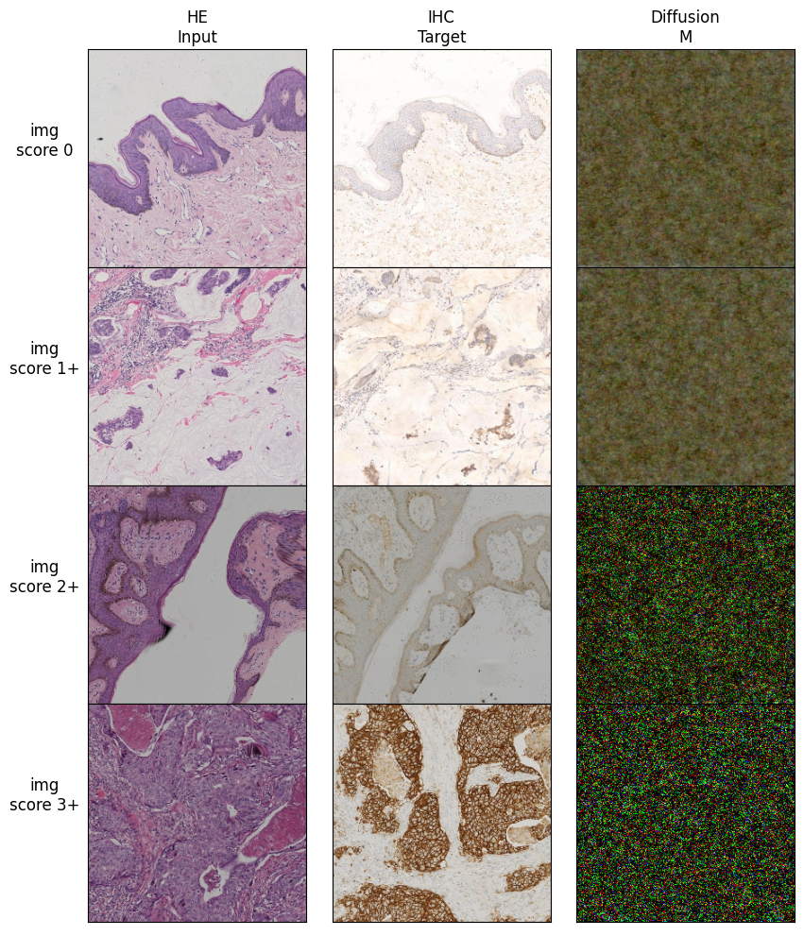
Qualitative Results Diffusion model

Slide 22
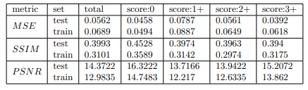
Interpretation of Quantitative Results
The Swin transformer shows the lowest MSE and highest PSNR on the test set while the U-Net L scores the Highest SSIM
All models score better on image pairs with a low IHC score (0,1+)
The scores on the test set are better than on the train set => the investigation shows that the pairs in the test set are closer than in the train set for the chosen metrics :

Slide 23
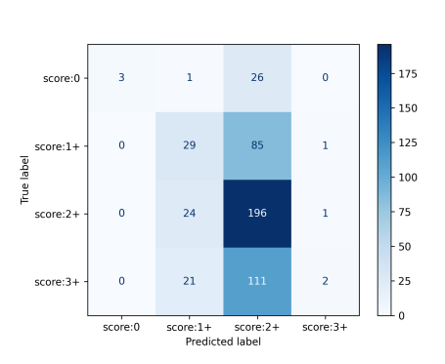
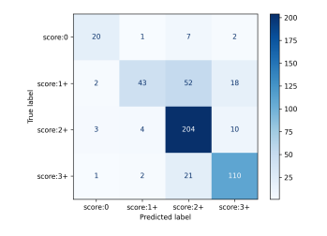
Interpretation of Qualitative Results
the models generate the basic structure of the IHC stained image but have trouble to generate the dark patches with high IHC score
the pretrained classifier was not able to function properly on the generated images
classifier on original IHC imgs
ACC: 75.4%
classifier on Swin T generated imgs
ACC: 46%

Slide 24
Architecture Results
VIT based model have problems to generate details due to the limit of the patch size
complex U-Nets perform better than simple ones
Pix2Pix framework does not have a big impact
diffusion model does not produce satisfactory results

Slide 25
Conclusion & Outlook
Although U-Net L and Swin T are able to generate the basic structure of the IHC stained ground truth, all models struggle to generate IHC images with a high HER2 expression.

Slide 26
Conclusion & Outlook
Although U-Net L and Swin T are able to generate the basic structure of the IHC stained ground truth, all models struggle to generate IHC images with a high HER2 expression.
extend the visual evaluation with expert pathologist opinion
develop a Pix2Pix framework with a special Descriminator which predicts the IHC score

